Slide 1




ONE WEEK ONLINE REFRESHER COURSE
ON
RESEARCH METHODOLOGY & DATA ANALYSIS
(February 21st - 27th, 2025)
Organized by
Faculty of Nursing
SGT University, Gurugram, Haryana
&
Resilient Foundation For Academic Innovation & Scientific Research, New Delhi
(Registered with NITI Aayog, Govt. of India)

Slide 2



ONE WEEK ONLINE WORKSHOP ON RESEARCH METHODOLOGY &
DATA ANALYSIS
( 22nd April- 28th April, 2024)
About SGT University, Gurugram:
SGT University (Shree Guru Gobind Singh Tricentenary University) is a NAAC A+ accredited State Private University established in 2013, committed to its mission of providing “Access to Quality Education for All.” Inspired by the teachings of Shree Guru Gobind Singh Ji, who advocated that “the spread of learning is the best service to mankind,” we strive to advance education and foster societal development.
About Faculty of Nursing:
The Faculty of Nursing is devoted to preparing competent nurse graduates through an outcome-based educational framework in alignment with the National Education Policy (NEP). Our curriculum is designed to address the dynamic demands of healthcare services across hospitals, communities, and society.
About Resilient Foundation :
Resilient Foundation for Academic Innovation & Scientific Research, New Delhi is a not-for-profit organization registered under section 8 of the companies’ act 2013, India. The organization is established having primary aim to promote academic & research activities through knowledge sharing, innovation, skill development and capacity building in various sectors like academia, industry and government for betterment of society. For more details please visit https://theresilientfoundation.org/

Slide 3

Objective of the Refresher Course:
During the COVID-19 pandemic, the virtual academic engagement is resultant more productive and gives a better outcome. Keeping in view of the immense benefits of the online academic events in the present educational set-up, Faculty of Nursing, SGT University & Resilient Foundation for Academic Innovation & Scientific Research, New Delhi are pleased to offer One Week Online Refresher Course on Research Methodology & Data Analysis for the faculty members, research scholars, industry personals, researchers and UG/PG students in the country from 21st -27th February, 2025. The course aims to bring together faculties, researchers, and research scholars to exchange and share their experiences and research results on various aspects of research methodology and data analysis.
The expected outcome of the course:
At the end of course, participants would be able to:
Design the research question
Conduct the review of literature with advanced tools
Design the hypothesis
Identify suitable sampling techniques
Determine the appropriate sample size
Apply parametric & non parametric statistical tests
Prepare the dissertation and publish research paper in reputed journals

Slide 4
THE COURSE CONTENT
Day | Topics Covered | Date & time
Day-1 | Introduction to Research Formulating research question Setting of Hypothesis | Date: 21st Feb, 2025 Time: 02:00 PM-04:00 PM
Day-2 | Review of literature Application of AI-Based advanced tools for review of literature | Date: 22nd Feb, 2025 Time: 02:00 PM-04:00 PM
Day-3 | Data Collection Tools Various Sampling Techniques | Date: 23rd Feb, 2025 Time: 02:00 PM-04:00 PM
Day-4 | Sample Size Calculation for different research studies Hands on G*Power software | Date: 24th Feb, 2025 Time: 02:00 PM-04:00 PM
Day-5 | Statistical Data Analysis –I Measurement Scales Descriptive Statistics Graphical representation of data Parametric Tests: t-test (one sample, two samples), Paired-t test, ANOVA Hands on SPSS | Date: 25th Feb, 2025 Time: 02:00 PM-04:00 PM
Day-6 | Statistical Data Analysis –II Non-Parametric Tests Wald-Wolfowitz runs test, Mann-Whitney U test Kruskal-Wallis test, Median Test, Sign test, Wilcoxon’s matched pairs test, Chi square test Hands on SPSS | Date: 26th Feb, 2025 Time: 02:00 PM-04:00 PM
Day-7 | Report Writing Research Publication Concept of Plagiarism | Date: 27th Feb, 2025 Time: 02:00 PM-04:00 PM

Slide 5



Methodology
Online live classes by eminent experts from reputed organizations of the country
Participatory discussion with Q&A
Demonstrations
Exercises and data analysis sessions using SPSS
Study materials such as ppt & recordings of the all sessions
Nature of Participants
Faculties, research scholars, medical students, post-doctoral fellows, industry professionals , UG, PG students etc.
Duration &Time
One Week (21st -27th February, 2025)
Timing (02 Hours): 02:00 PM-04:00 PM
Registration Process:
Step-I: Fee Payment:
  Registration Fee for SGT students = Rs. 300/-
Payment link for SGT students
https://pmny.in/SIUlJHmykxd3
  Registration Fee for SGT Faculties = Rs. 400/-
  Payment link for SGT Faculties
  3. Registration Fee for all candidates other than SGT University = Rs. 600/-
Payment link for all candidates other than SGT University https://pmny.in/NrfJCavnwAwU
.

Slide 6




Workshop Rule
Highlights of the Workshop-
Registered participants will get e-certificates
Study material in the form of video recording of all sessions will be provided to all registered participants.
Workshop by Subject Experts from reputed Institute & Universities
Workshop will be on the Zoom meeting platform.
For further queries, please mail us at : info@resilientfoundation.in
or call at +91-8840112492.
Last Date of Registration: 20th Feb, 2025

Slide 7

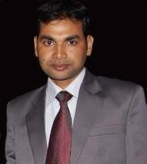
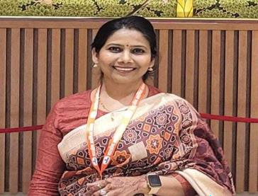
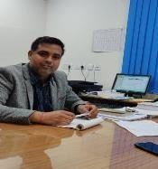
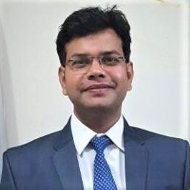
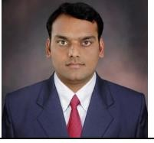
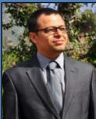
About Resource Persons
Dr. S. K. Yadav is currently working as Associate Professor at Department of Statistics, Baba saheb Bhimrao Ambedkar University (A Central University), Lucknow. He did his M.Sc. and Ph.D. from Department of Statistics, University of Lucknow. He has teaching and research experience of more than 10 years in the field of Statistics. He has published more than 100 research papers in various national and international journals.
Dr. Gayatri Vishwakarma is an experienced Biostatistician having 14+ years of post-PhD work experience in academics and research. Dr. Gayatri is currently working as Principal Scientist at ZYDUS Life Sciences, Ltd., Ahmedabad, Gujrat. She has been the Head- Biostatistics at ISIC, New Delhi. She worked as Biostatistician with Department of Research at Rajiv Gandhi Cancer Institute, New Delhi. She worked as Visiting Scientist at University of Texas Health Science Center, Tyler TX, USA
Dr. Anup Kumar is, Associate Professor, Department of Biostatistics, & Health Informatics, SGPGIMS, Lucknow has completed his Ph.D. from Banaras Hindu University, Varanasi in the field of Mathematical Modeling of Human Fertility in 2012. Currently his area of interested is Stochastic Modelling, Big Data Analysis, Text Mining and Biostatistics. He has published more than 20 research articles in reputed international and national journal.
Dr. D.K.Yadav is currently working as Assistant Professor at National Institute of Health & Family Welfare (NIHFW), New Delhi. He has done his M.Sc. & Ph.D. in Statistics from University of Lucknow. Dr. Yadav has published more than 50 research articles in various national and international journals. He is editor of 10 edited books. He has received various national and international awards for his outstanding research.
Dr Vinit Kumar is Assistant Professor at Dept. of Library & Information Science, Baba saheb Bhimrao Ambedkar University (A Central University), Lucknow. He completed his Ph.D. from Indian Statistical Institute, Kolkata. He has more than 12 years teaching and research experience. His areas of expertise are research methodology, AI &ML and text mining.
Dr. Yusuf Akhter is Assistant Professor at Dept. of Biotechnology Babasaheb Bhimrao Ambedkar University,. He has completed his Ph.D. from European Molecular Biology Laboratory, Hamburg Germany/Center for DNA Fingerprinting & Diagnostics, Hyderabad, India. He has been DAAD Post Doctoral Fellow at European Molecular Biology Laboratory, Hamburg, Germany He has more than 120 publications in various journals of national and intgernational repute.

Slide 8
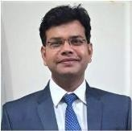
Organising Team of the Workshop
Patron
Dr. Madan Mohan Chaturvedi
Officiating Vice – Chancellor
SGT University
Co - Patron
Workshop Coordinators
Dr. D.K. Yadav Assistant Professor NIHFW, New Delhi
(Organizing Secretary)
Advisory Board
Co - Coordinators

